Slide 1

Brief Walkthrough of Food Order Website
DC125222 Lee Cheok Hin
By

Slide 2
CONTENTS
Abstract
Walk Through

Slide 3

01
Abstract

Slide 4
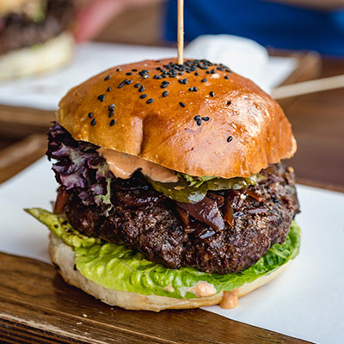
Abstract
As the pace of life is faster and faster, food order platform becomes a good helper for people to have meals.
Via this food order website can:
Manage admin accounts
Manage categories and foods
Manage orders
Search foods
Order foods

Slide 5
02
Walkthrough

Slide 6
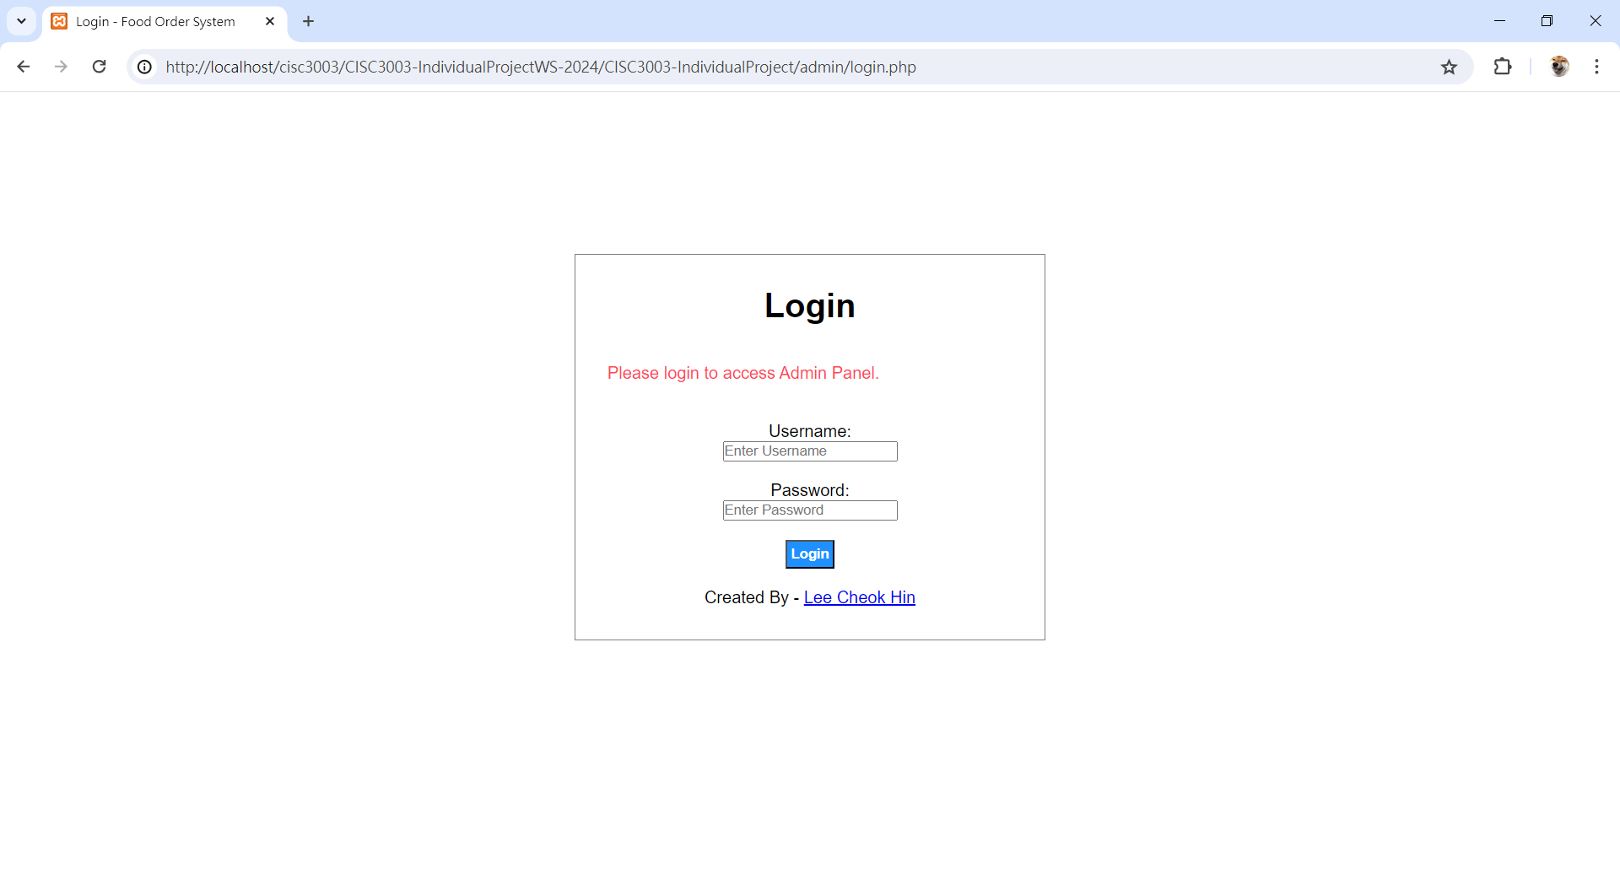
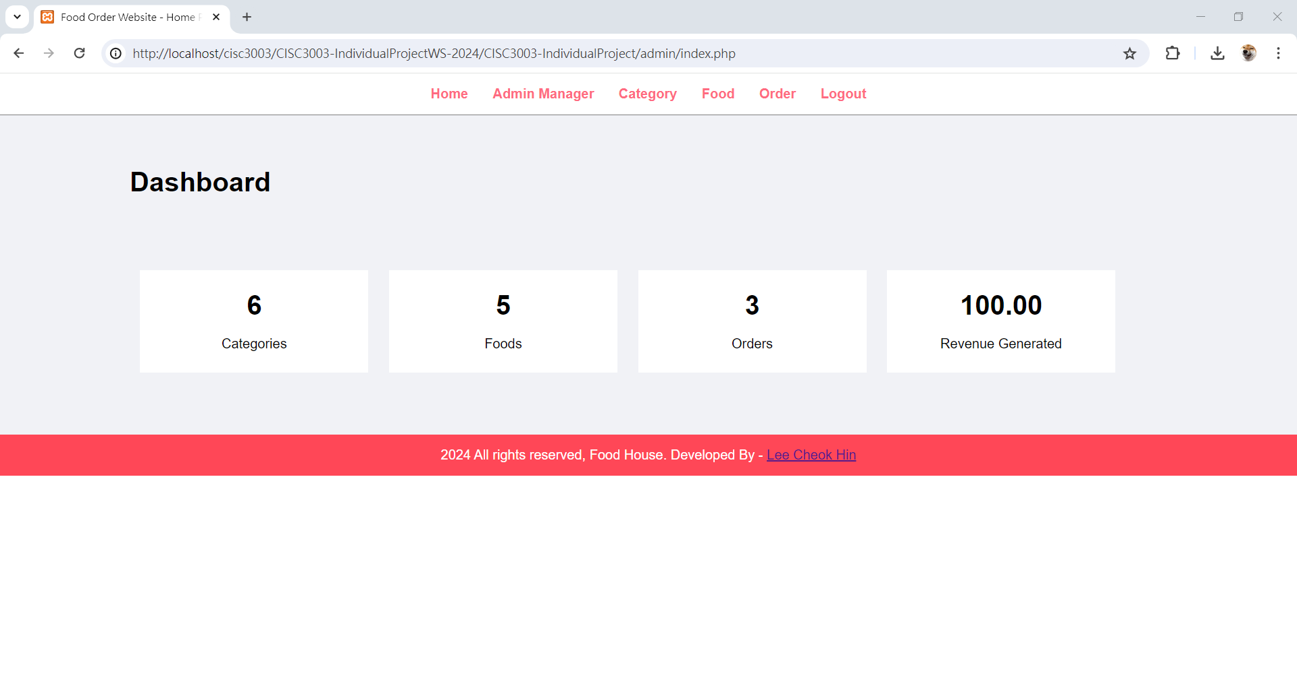
Manage Page
02
Login to admin page and manage admin account

Slide 7
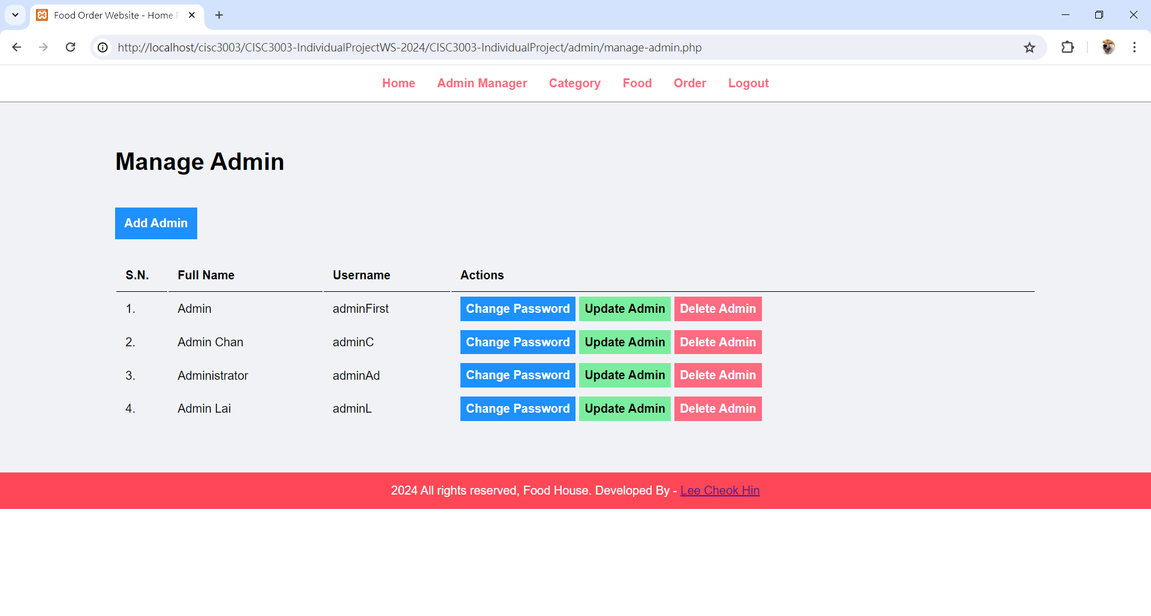
Admins Page
Login to admin page and manage admin account – Manage admin page

Slide 8
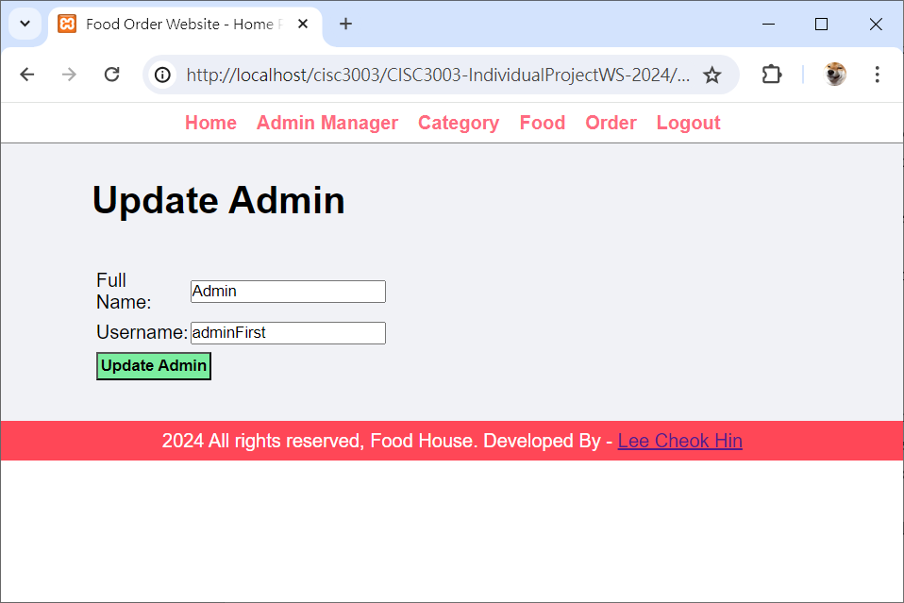
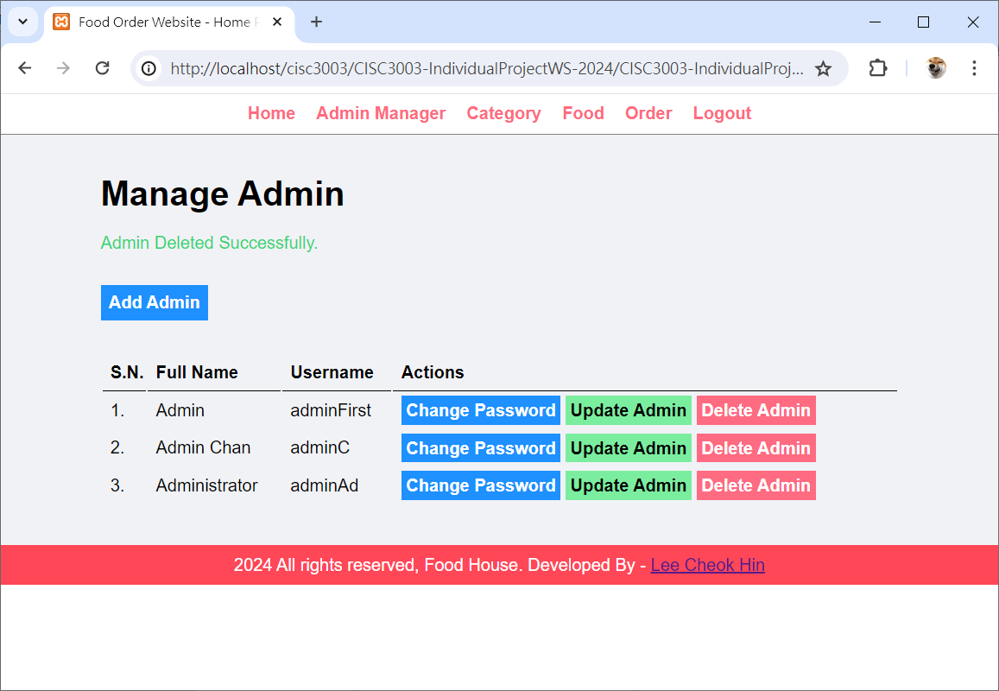
Admins Page
Update the account information and Delete admin account

Slide 9
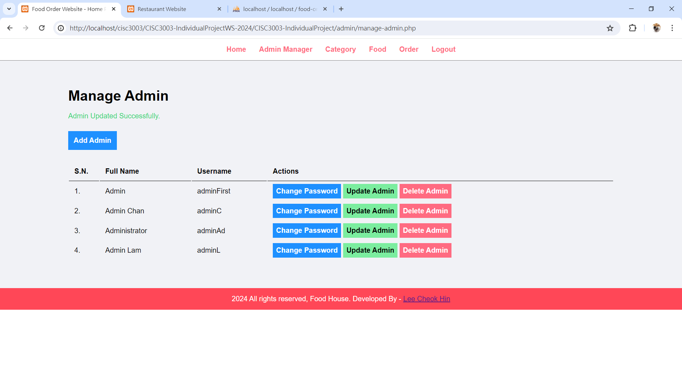
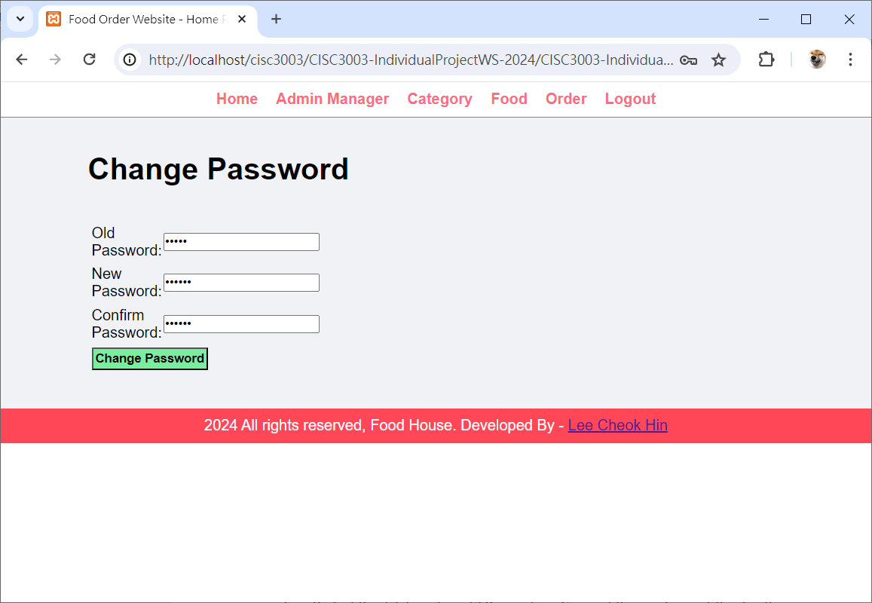
Admins Page
Changing Password and Add Admin Account

Slide 10
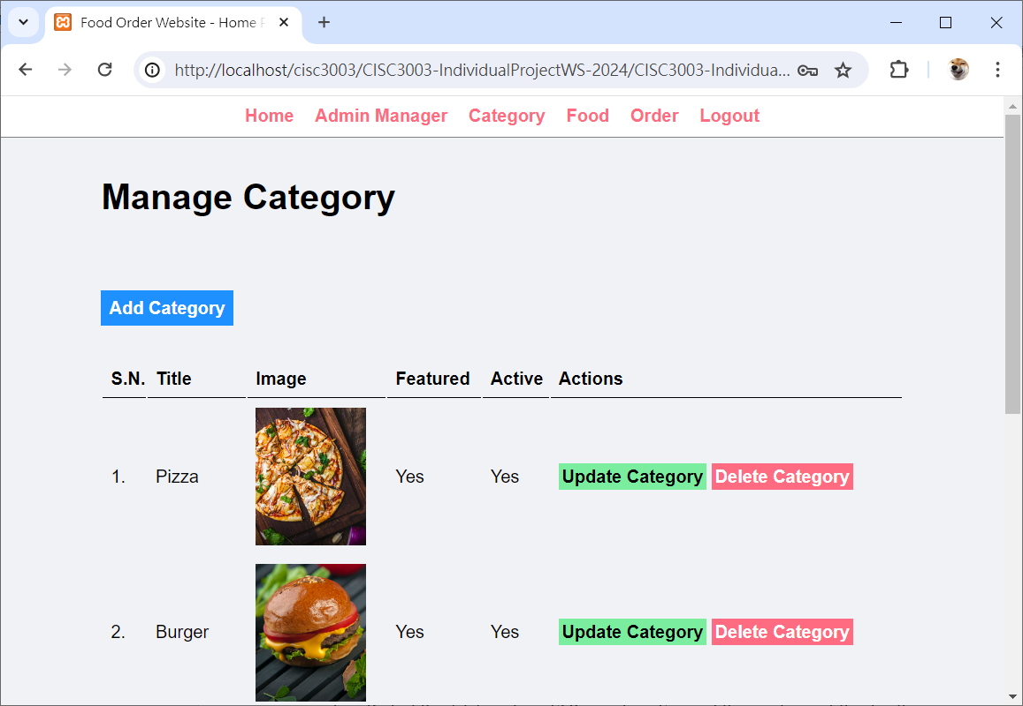
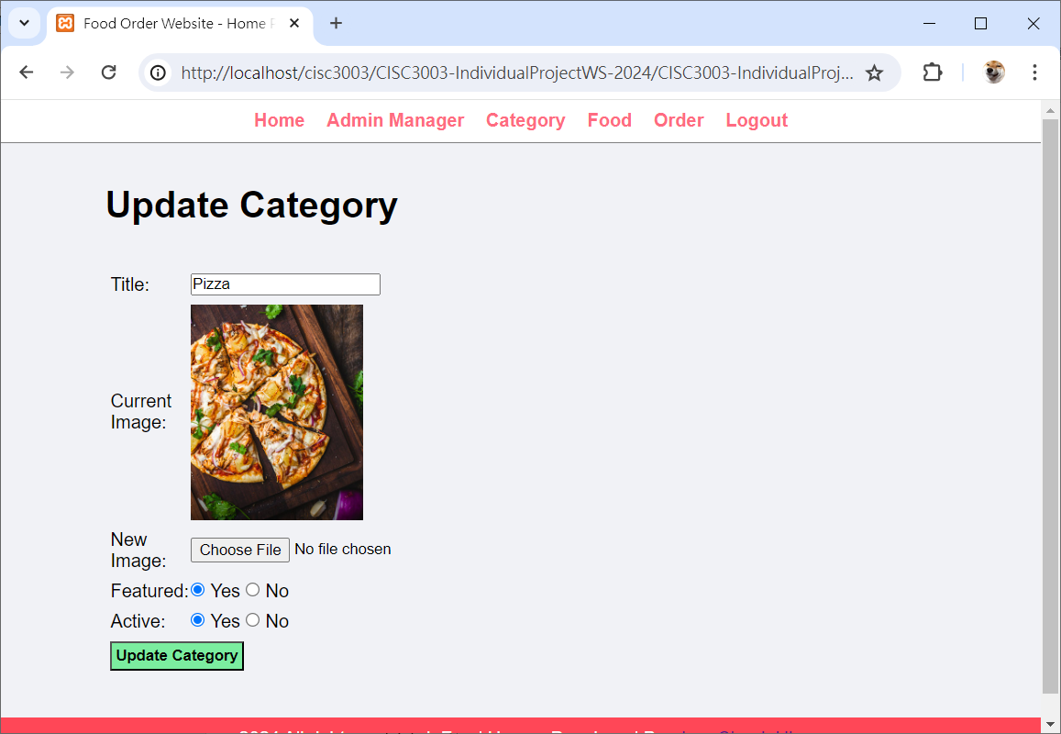
Categories Page
02
Manage Categories data and Update the data

Slide 11
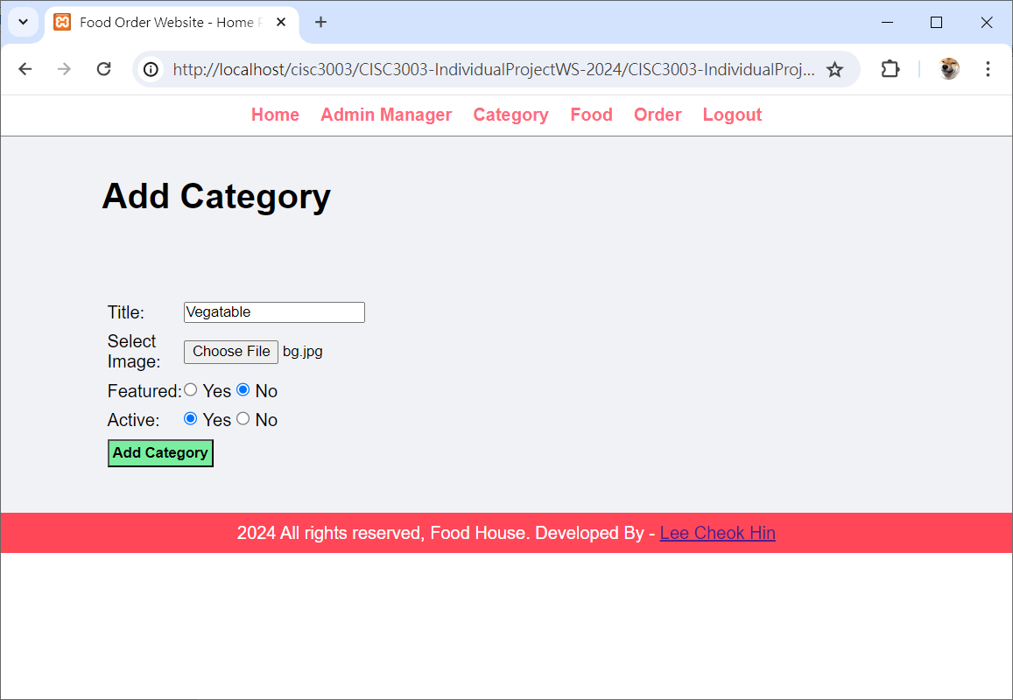
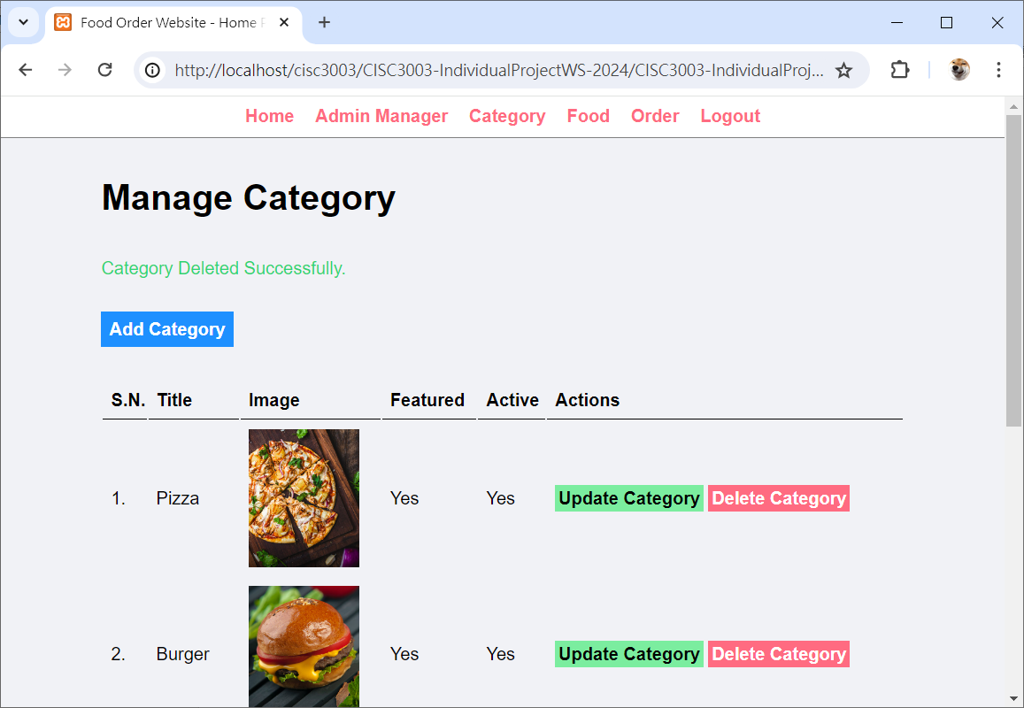
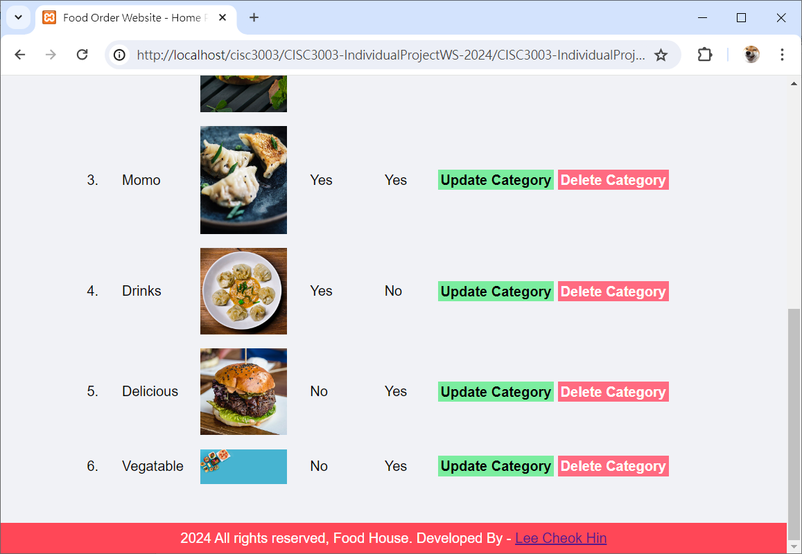
Categories Page
02
Categories Deletion and Addition

Slide 12
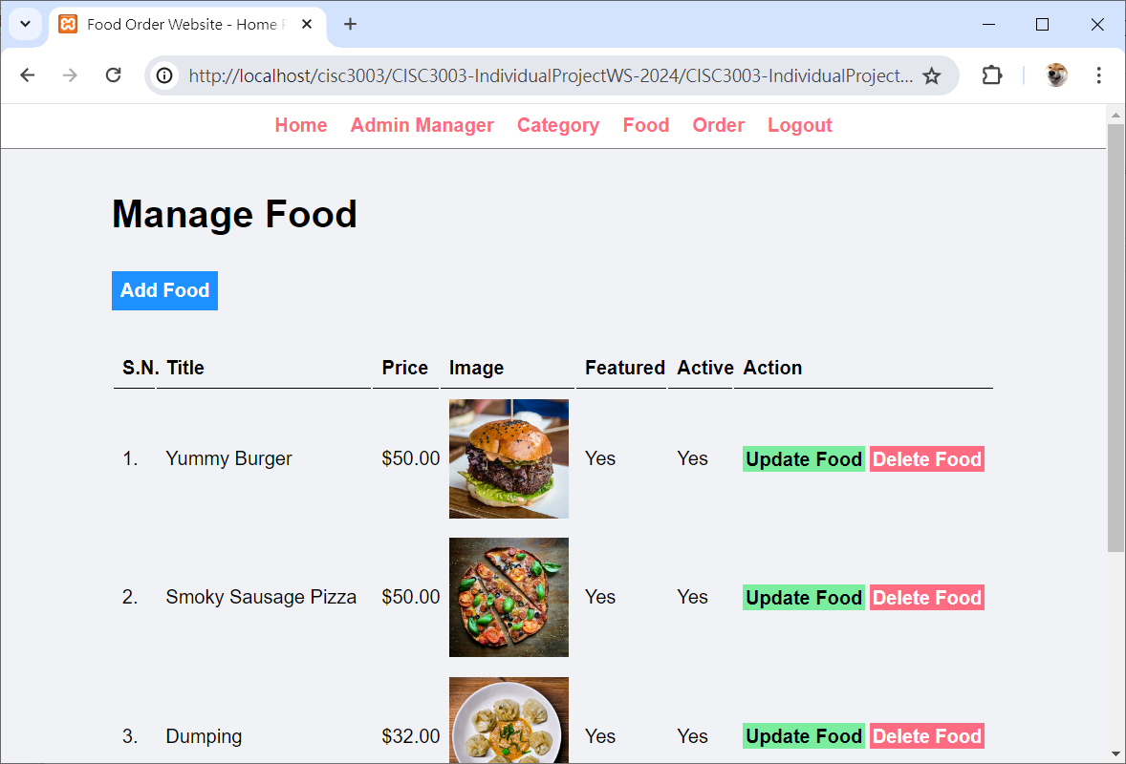
Foods Page
02
Food Management on this page

Slide 13
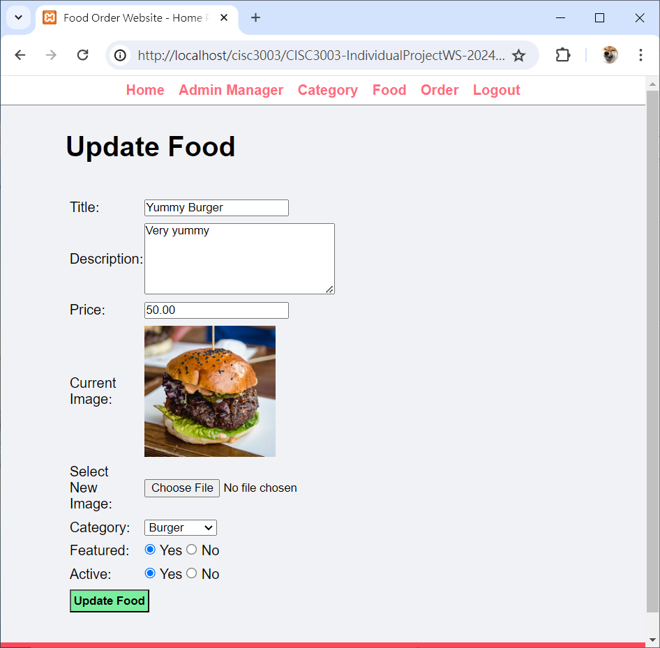
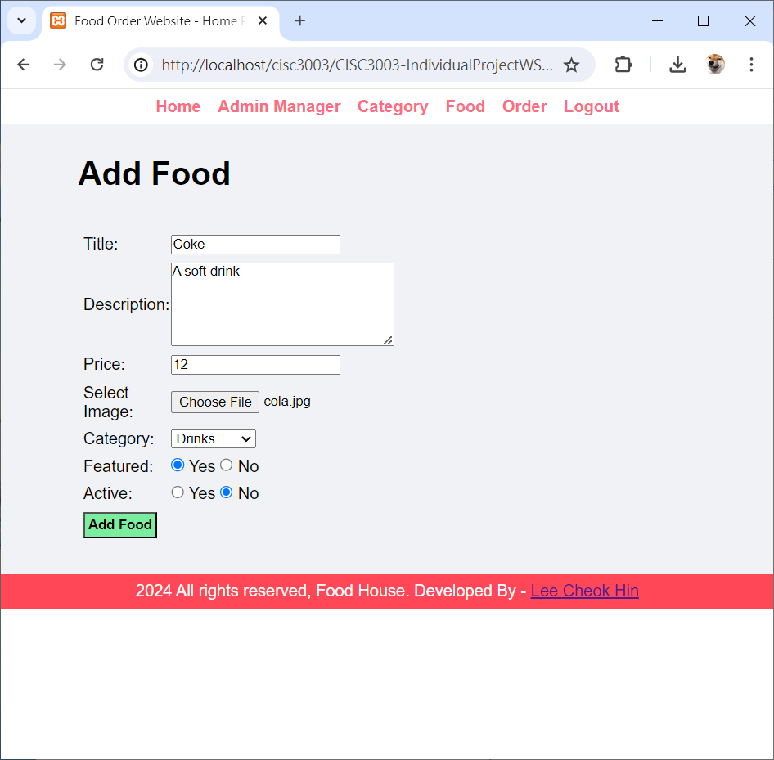
Foods Page
02
Food Updating and Adding via Foods Page
Food Addition
Food Updating

Slide 14
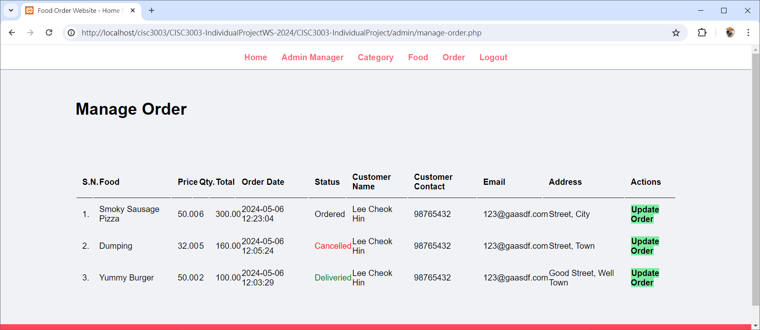
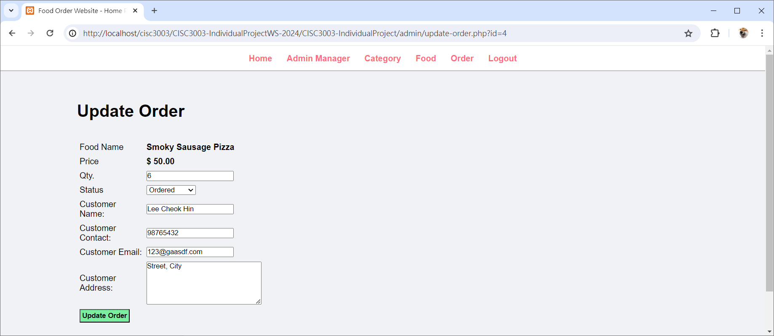
Orders Page
02
View the Information of orders and Update

Slide 15
Orders Page
02
View the Information of orders and Update

Slide 16
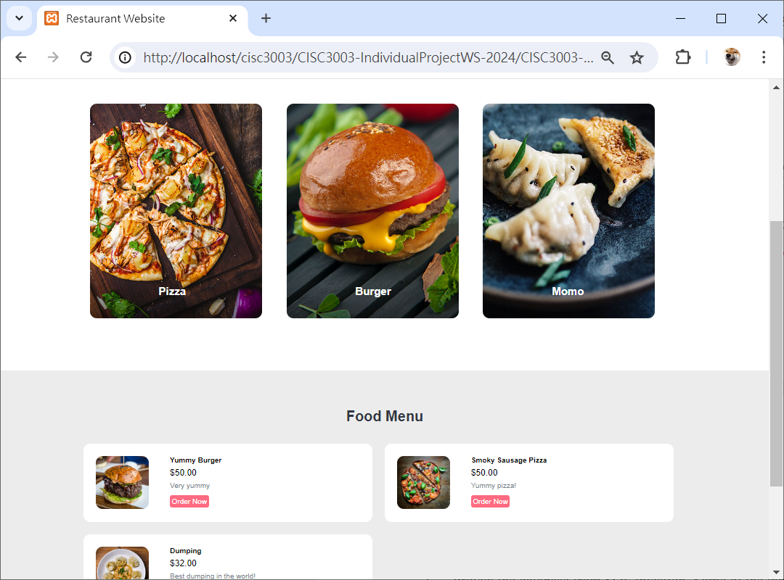
Home Page
02
Shows the Featured Categories and Foods

Slide 17
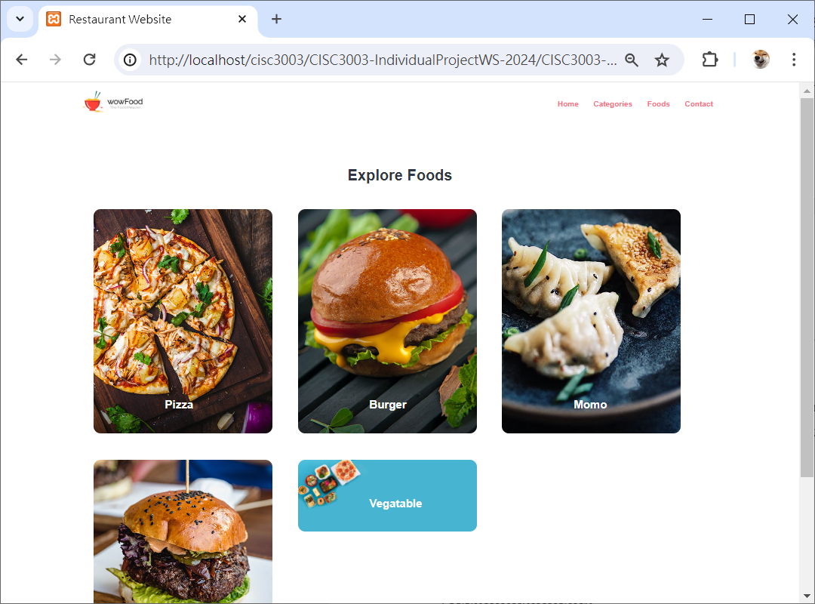
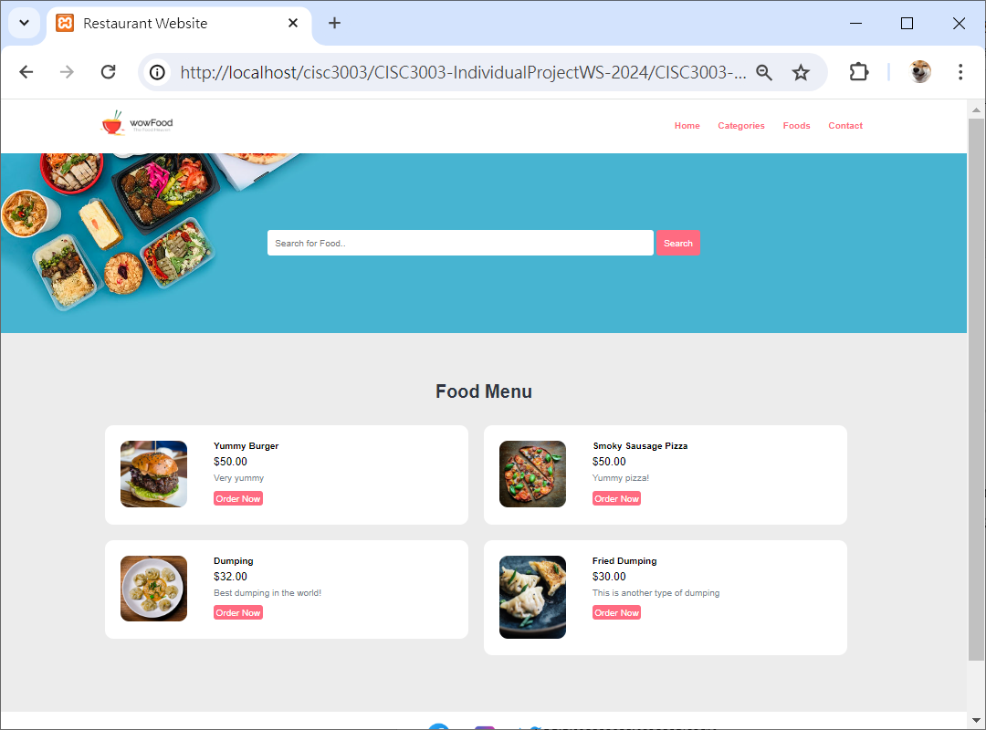
Categories Page & Foods Page
02
Shows all the Available Categories and Foods

Slide 18
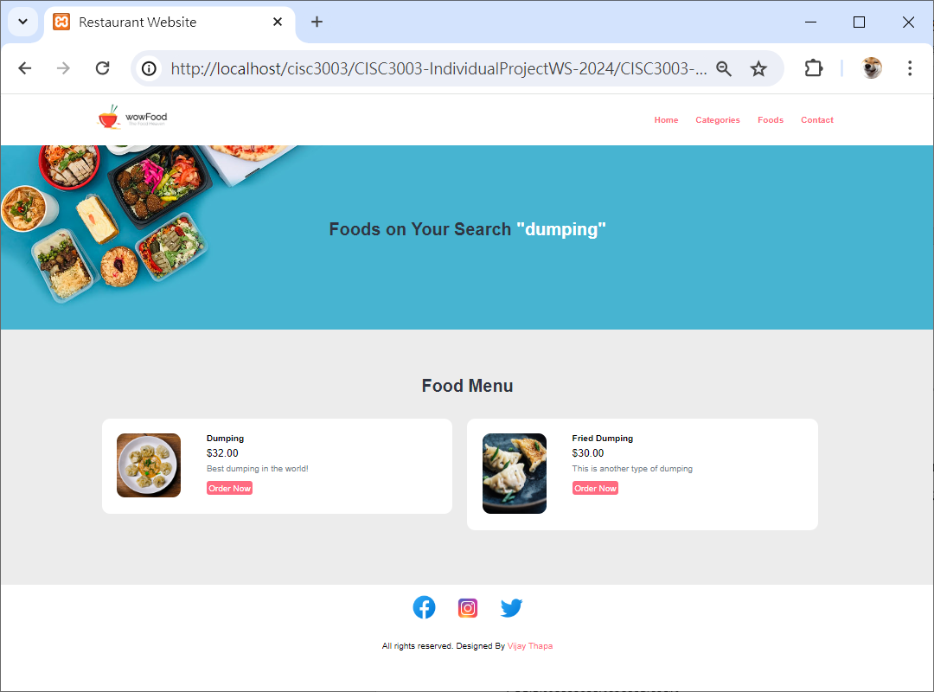
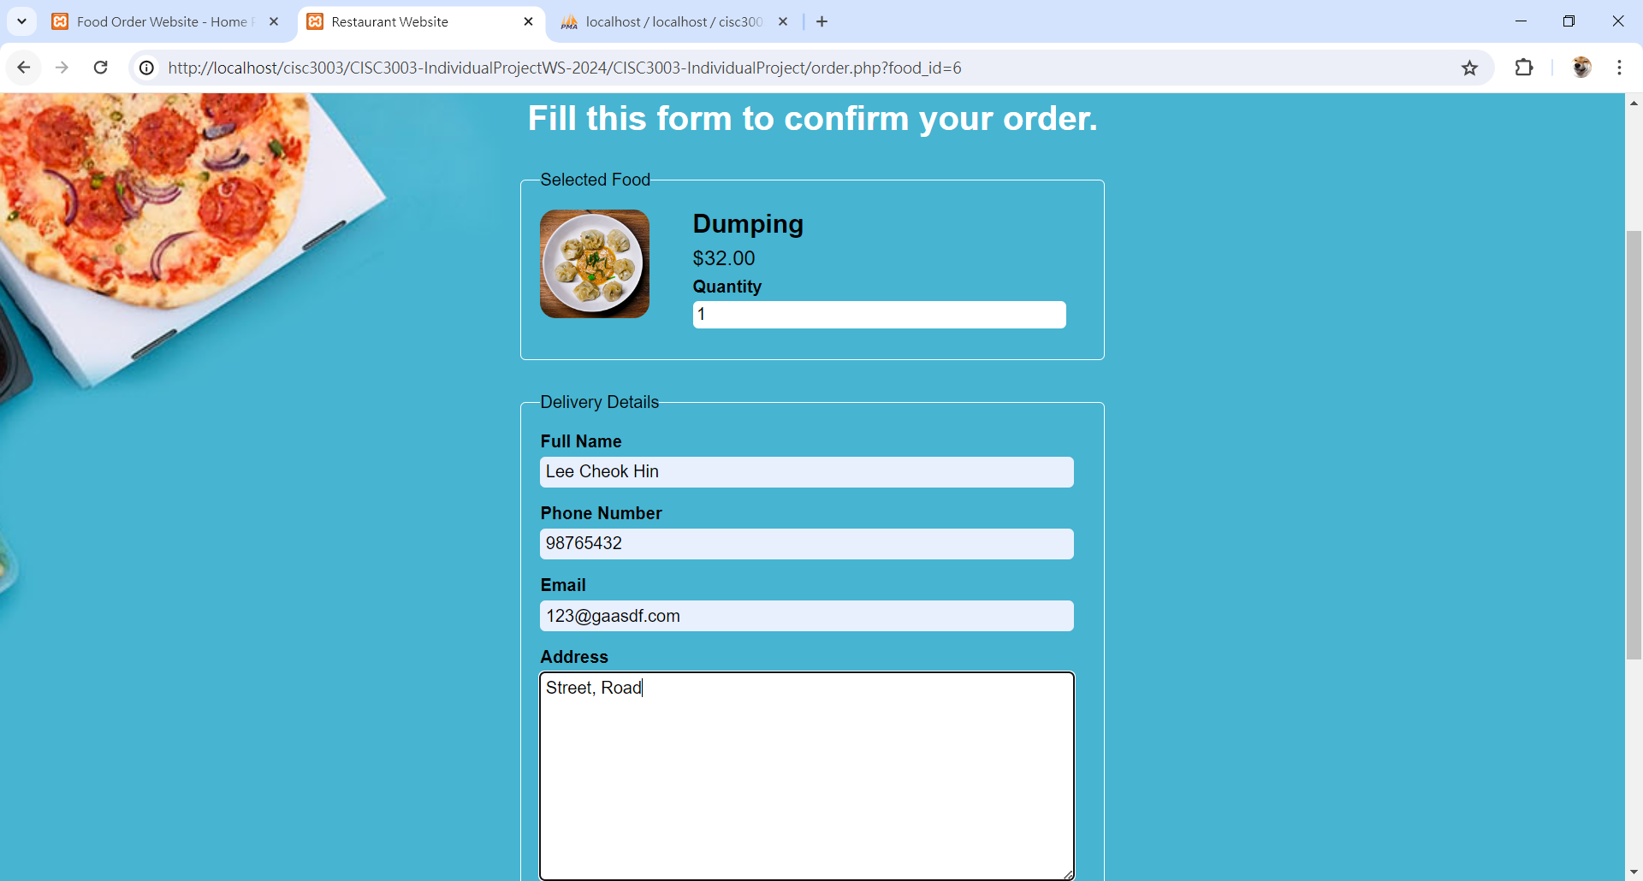
Search Page & Orders Page
Search the Food Base on the Keywords and Make an Order for Foods

Slide 19
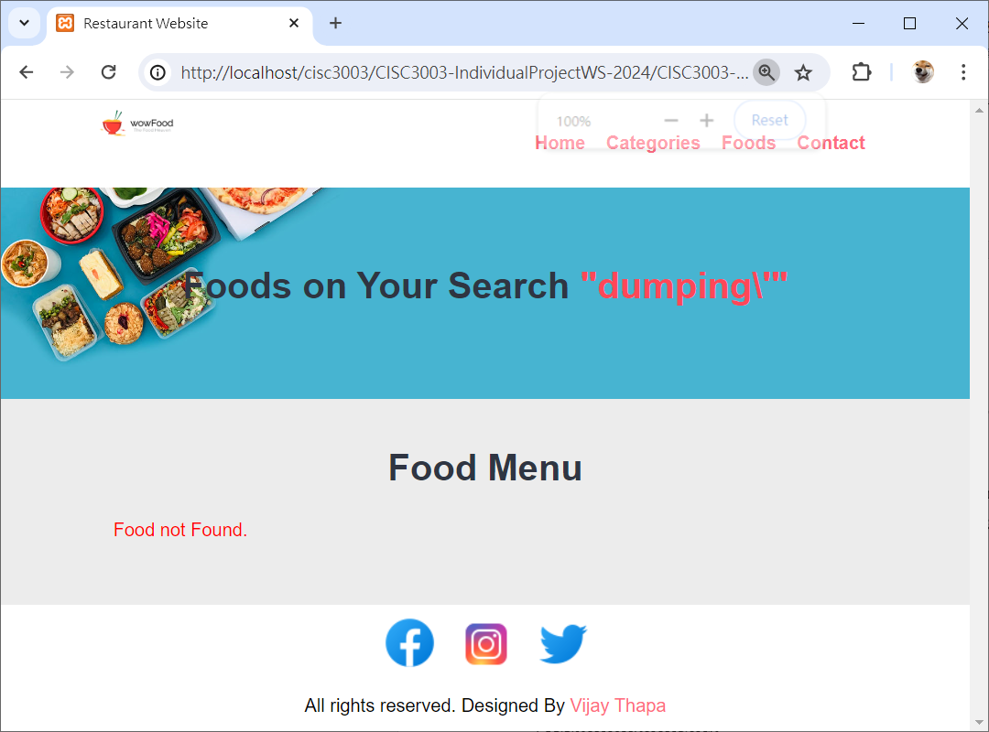
Prevent SQL Injection
Users cannot do the SQL Injection at the Search Bar
Input “dumping’”

Slide 20
Thanks！
by
Tan Hongye

